Slide 1
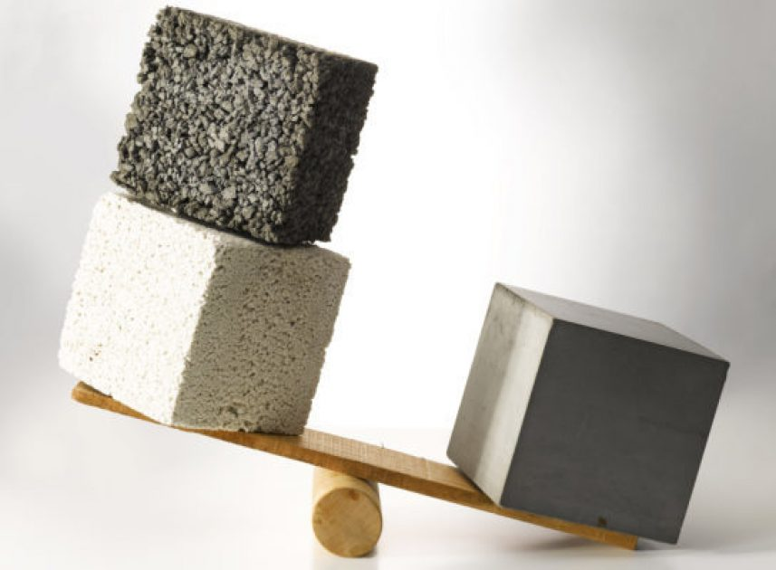
LIGHTWEIGHT CONCRETE

Slide 2
CONTENT
Introduction
Properties of light weight concrete
Types of light weight concrete
Application of light weight concrete
Advantages of light weight concrete
Disadvantages of light weight concrete
Case study of floating concrete

Slide 3
INTRODUCTION
Concrete elements are the heaviest weight in structure, and it is the main component of the dead load in structure. Lightweight concrete is used to minimize overall dead load in structures.
Lightweight concrete is a special type of concrete which weighs lighter than conventional or normal concrete.
Lightweight aggregate concrete is prepared by using lightweight aggregate or low density aggregate such as volcanic pumice, clay, slate, shale, scoria, tuff pellite etc.
Density of light weight concrete is conventionally low. Generally 300 kg/m³ to 2000 kg/m³
Lightweight concrete has more volume of the mixture as compared to conventional concrete.

Slide 4
Properties of Lightweight Concrete:
Low Density- The density of concrete varies from 300 to 1200 kg/m³. The lightest grade suited for insulation proposed while the heavier grades with adequate strength suited for structural applications
Fire Resistance- Lightweight concrete has excellent fire-resisting properties.
Thermal insulation- The insulation value of lightweight concrete is about three to six, times that of bricks and about ten times of concrete.

Slide 5
Types of Lightweight Concrete
Lightweight Aggregate Concrete
No-Fines Concrete
Aerated Concrete

Slide 6
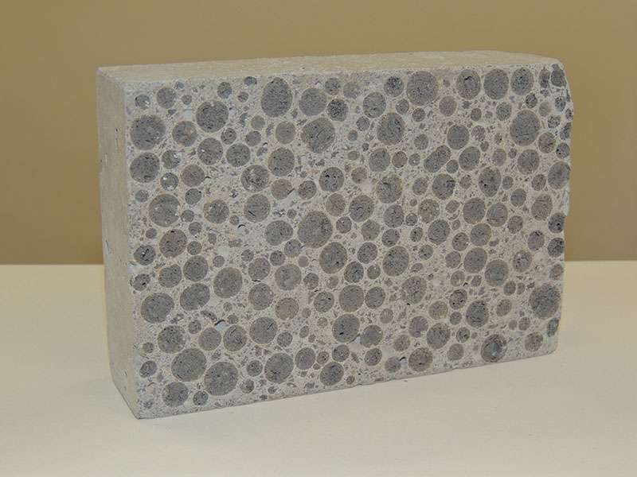
Lightweight Aggregate Concrete-
When producing lightweight aggregate concrete, an effort is taken to ensure that the aggregates used are light in weight. The most common types of aggregates are natural aggregates (Pumice, Diatomite, Rice Husk etc.) and man-made aggregates(Foamed Slag, Bloated Clay, Thermocol bids etc.).

Slide 7
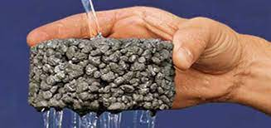
No-Fines Concrete
No fine aggregates are utilized in the production of No-Fines concrete. The only ingredients utilized are cement, coarse aggregates, and water. The concrete will have bigger voids, making it lightweight.

Slide 8
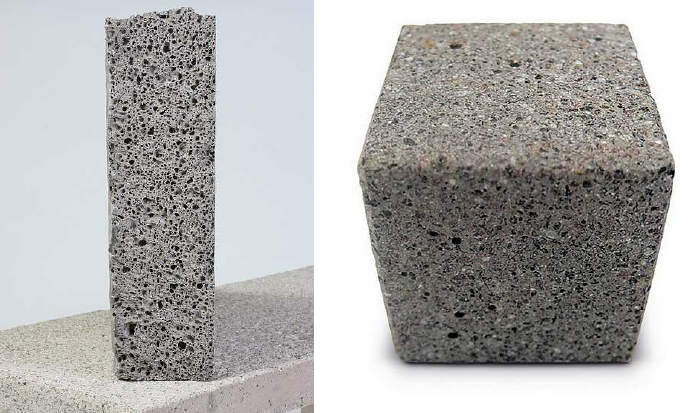
Aerated Concrete
These types of concrete are made by the introduction of voids in the concrete to reduce the weight of the concrete the usual method of aeration are by mixing in stabilized foam or by add an air entraining agent. Aerated concrete has the lowest density, thermal conductivity and strength

Slide 9
Applications Of Lightweight Concrete
Because LWC has a low strength, it is utilized in the building of roof slabs, tiny houses with load-bearing walls.
These are formed into slabs and utilized as thermal insulators throughout the building.
It is also employed in the construction of staircases, windows, and garden walls.
This is utilized in the construction of partition walls in large buildings.
It can also help in covering architectural purposes.

Slide 10
Advantages Of Lightweight Concrete
It minimizes the dead load of the building.
It is simple to handle, which decreases the cost of transportation and handling.
Enhances workability.
Thermal conductivity is decreased with lightweight concrete.
The use of lightweight concrete in the rooms where air conditioning is to be installed during the building’s construction would result in good thermal comfort and decreased power usage.
The use of lightweight concrete provides an outlet for industrial wastes such as fly ash, clinkers, slag, and so on, which cause problems in landfills.

Slide 11
Disadvantages Of Lightweight Concrete
Lightweight concrete is often particularly sensitive to the amount of water in the mix.
To ensure the correct mixing of concrete, the mixing period is longer than that of standard concrete.
Lightweight concrete is porous and has a low resistance.
In rare situations, cement mortar may separate the aggregates and cause them to float on the surface.
Because of the porosity and angularity of the aggregate, placement and finishing are difficult, necessitating the use of experienced labor.

Slide 12
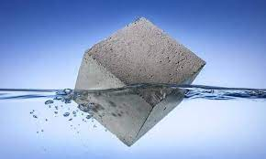
Case study (Floating concrete)
Cement- JK Super OPC-53
Fine aggregate- M.Sand
Coarse aggregate- Thermocol bids
Chemicals- Superplasticizer , Air in.

Slide 13
THANK YOU!

